Slide 1
Unit 5:
System Modeling

Slide 2
System Modeling
The aim of this chapter is to introduce some types of system model that may be developed as part of the requirements engineering and system design processes.
Studying this unit we will
■ understand how graphical models can be used to represent software systems
■ understand why different types of model are required and the fundamental system modeling perspectives of context, interaction, structure, and behavior
■ have been introduced to some of the diagram types in the Unified Modeling Language (UML) and how these diagrams may be used in system modeling
■ be aware of the ideas underlying model-driven engineering, where a system is automatically generated from structural and behavioral models

Slide 3
System Modeling
System modeling is the process of developing abstract models of a system, with each model presenting a different view or perspective of that system.
System modeling has generally come to mean representing the system using some kind of graphical notation, which is now almost always based on notations in the Unified Modeling Language (UML).
It is also possible to develop formal (mathematical) models of a system, usually as a detailed system specification.

Slide 4
System Modeling
Models are used
During the requirements engineering process to help derive the requirements for a system
During the design process to describe the system to engineers implementing the system and
After implementation to document the system’s structure and operation.

Slide 5
System Modeling
Models
A model is an abstraction of the system being studied rather than an alternative representation of that system.
Ideally, a representation of a system should maintain all the information about the entity being represented.
An abstraction deliberately simplifies and picks out the most salient characteristics

Slide 6
System Modeling
You may develop models of both the existing system and the system to be developed:
Models of the existing system are used during requirements engineering. They help clarify what the existing system does and can be used as a basis for discussing its strengths and weaknesses. These then lead to requirements for the new system.

Slide 7
System Modeling
You may develop models of both the existing system and the system to be developed:
Models of the new system are used during requirements engineering to help explain the proposed requirements to other system stakeholders. Engineers use these models to discuss design proposals and to document the system for implementation.

Slide 8
System Modeling
In a model-driven engineering process, it is possible to generate a complete or partial system implementation from the system model.

Slide 9
System Modeling
The UML has many diagram types and so supports the creation of many different types of system model:
Activity diagrams
Use case diagrams
Sequence diagrams
Class diagrams
State diagrams

Slide 10
System Modeling
The UML has many diagram types and so supports the creation of many different types of system model:
Activity diagrams, which show the activities involved in a process or in data processing.
Use case diagrams, which show the interactions between a system and its environment.
Sequence diagrams, which show interactions between actors and the system and between system components.
Class diagrams, which show the object classes in the system and the associations between these classes.
State diagrams, which show how the system reacts to internal and external events.

Slide 11
System Modeling
You may develop different models to represent the system from different perspectives. For example:
An external perspective
An interaction perspective
A structural perspective
A behavioral perspective

Slide 12
System Modeling
You may develop different models to represent the system from different perspectives. For example:
An external perspective, where you model the context or environment of the system.
An interaction perspective, where you model the interactions between a system and its environment or between the components of a system.
A structural perspective, where you model the organization of a system or the structure of the data that is processed by the system.
A behavioral perspective, where you model the dynamic behavior of the system and how it responds to events.

Slide 13
Context Modeling
Context models are used to illustrate the operational context of a system - they show what lies outside the system boundaries.
Social and organisational concerns may affect the decision on where to position system boundaries.
Architectural models show the system and its relationship with other systems.
The definition of a system boundary is not a value-free judgment. Social and organizational concerns may mean that the position of a system boundary may be determined by non-technical factors.

Slide 14
Context Modeling
For example,
A system boundary may be
deliberately positioned so that the analysis process can all be carried out on one site
it may be chosen so that a particularly difficult manager need not be consulted
it may be positioned so that the system cost is increased and the system development division must therefore expand to design and implement the system.
Once some decisions on the boundaries of the system have been made, part of the analysis activity is the definition of that context and the dependencies that a system has on its environment. Normally, producing a simple architectural model is the first step in this activity.

Slide 15
Context Modeling
Context models normally show that the environment includes several other automated systems.
They do not show the types of relationships between the systems in the environment and the system that is being specified.
External systems might produce data for or consume data from the system. They might share data with the system, or they might be connected directly, through a network or not connected at all.
All of these relations may affect the requirements and design of the system being defined and must be taken into account.
Therefore, simple context models are used along with other models, such as business process models. These describe human and automated processes in which particular software systems are used.

Slide 16
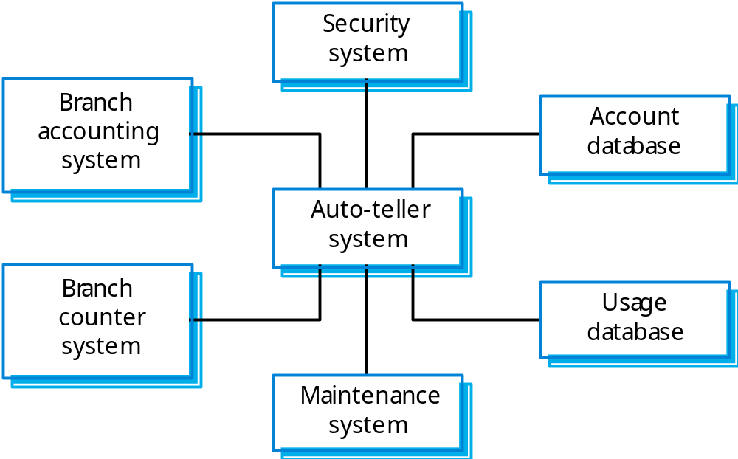
Context Modeling
The context of an ATM system

Slide 17
Interaction Modeling
All systems involve interaction of some kind.
This can be user interaction, which involves user inputs and outputs, interaction between the system being developed and other systems or interaction between the components of the system.
Modeling user interaction is important as it helps to identify user requirements.
Modeling system to system interaction highlights the communication problems that may arise.
Modeling component interaction helps us understand if a proposed system structure is likely to deliver the required system performance and dependability

Slide 18
Interaction Modeling
Two approaches to interaction modeling.
Use case modeling, which is mostly used to model interactions between a system and external actors (users or other systems).
Sequence diagrams, which are used to model interactions between system components, although external agents may also be included.
The UML also includes communication diagrams that can be used to model interactions.

Slide 19
Interaction Modeling
Use case modeling
Which is mostly used to model interactions between a system and external actors (users or other systems).
Use case modeling is widely used to support requirements elicitation. A use case can be taken as a simple scenario that describes what a user expects from a system.

Slide 20
Interaction Modeling
Use case modeling
Use case diagrams give a fairly simple overview of an interaction so you have to provide more detail to understand what is involved.
This detail can either be a simple textual description, a structured description in a table, or a sequence diagram
You chose the most appropriate format depending on the use case and the level of detail that you think is required in the model.

Slide 21
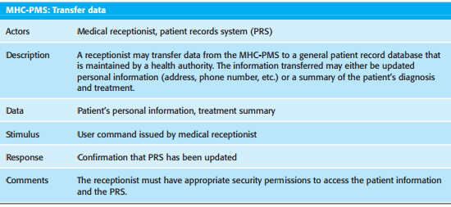
Interaction Modeling
Use case modeling
Tabular description of the ‘Transfer data’ use case

Slide 22

Interaction Modeling
Use case modeling
Transfer data use case

Slide 23
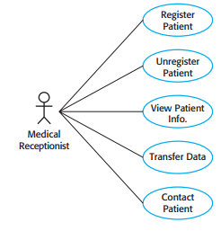
Interaction Modeling
Use case modeling
Use cases involving the role ‘medical receptionist’

Slide 24
Interaction Modeling
Sequence diagrams
Which are used to model interactions between system components, although external agents may also be included.
Sequence diagrams in the UML are primarily used to model the interactions between the actors and the objects in a system and the interactions between the objects themselves.
The UML has a rich syntax for sequence diagrams, which allows many different kinds of interaction to be modeled.

Slide 25
Interaction Modeling
Sequence diagrams
The objects and actors involved are listed along the top of the diagram, with a dotted line drawn vertically from these. Interactions between objects are indicated by annotated arrows.
The rectangle on the dotted lines indicates the lifeline of the object concerned (i.e., the time that object instance is involved in the computation).
You read the sequence of interactions from top to bottom. The annotations on the arrows indicate the calls to the objects, their parameters, and the return values. (In this example, I also show the notation used to denote alternatives.)
A box named alt is used with the conditions indicated in square brackets.

Slide 26
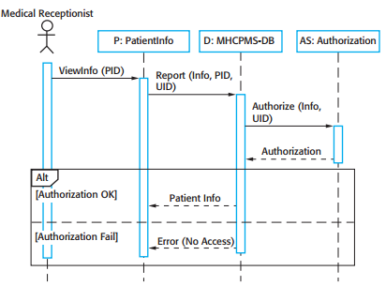
Interaction Modeling
Sequence diagrams
Sequence diagram for View patient information

Slide 27
Interaction Modeling
Sequence diagrams
The medical receptionist triggers the ViewInfo method in an instance P of the PatientInfo object class, supplying the patient’s identifier, PID. P is a user interface object, which is displayed as a form showing patient information.
The instance P calls the database to return the information required, supplying the receptionist’s identifier to allow security checking (at this stage, we do not care where this UID comes from).
The database checks with an authorization system that the user is authorized for this action.
If authorized, the patient information is returned and a form on the user’s screen is filled in. If authorization fails, then an error message is returned.

Slide 28
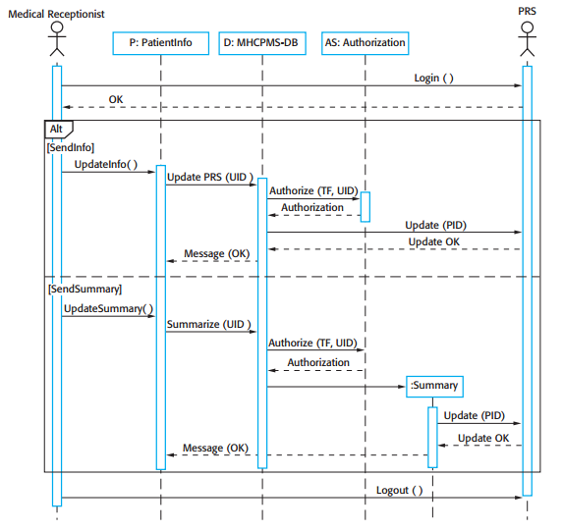
Interaction Modeling
Sequence diagrams
Sequence diagram for transfer data

Slide 29
Interaction Modeling
Sequence diagrams
In the above Figure is a second example of a sequence diagram from the same system that illustrates two additional features.
These are the direct communication between the actors in the system and the creation of objects as part of a sequence of operations.
In this example, an object of type Summary is created to hold the summary data that is to be uploaded to the PRS (patient record system).

Slide 30
Interaction Modeling
Sequence diagrams
The receptionist logs on to the PRS.
There are two options available. These allow the direct transfer of updated patient information to the PRS and the transfer of summary health data from the MHC-PMS to the PRS.
In each case, the receptionist’s permissions are checked using the authorization system.
Personal information may be transferred directly from the user interface object to the PRS. Alternatively, a summary record may be created from the database and that record is then transferred.
On completion of the transfer, the PRS issues a status message and the user logs off.

Slide 31
Interaction Modeling
Sequence diagrams
Unless you are using sequence diagrams for code generation or detailed documentation, you don’t have to include every interaction in these diagrams.
If you develop system models early in the development process to support requirements engineering and high-level design, there will be many interactions which depend on implementation decisions.

Slide 32
Structure Modeling
Structural models of software display the organization of a system in terms of the components that make up that system and their relationships.
Structural models may be static models, which show the structure of the system design or dynamic models, which show the organization of the system when it is executing.
These are not the same things—the dynamic organization of a system as a set of interacting threads may be very different from a static model of the system components

Slide 33
Structure Modeling
You create structural models of a system when you are discussing and designing the system architecture.
Architectural design is a particularly important topic in software engineering and UML component, package, and deployment diagrams may all be used when presenting architectural models.

Slide 34
Structure Modeling
Class diagrams
Class diagrams are used when developing an object-oriented system model to show the classes in a system and the associations between these classes.
Loosely, an object class can be thought of as a general definition of one kind of system object.
An association is a link between classes that indicates that there is a relationship between these classes.
Consequently, each class may have to have some knowledge of its associated class

Slide 35
Structure Modeling
Class diagrams
Class diagrams in the UML can be expressed at different levels of detail.
When you are developing a model, the first stage is usually to look at the world, identify the essential objects, and represent these as classes.
The simplest way of writing these is to write the class name in a box.
You can also simply note the existence of an association by drawing a line between classes

Slide 36

Structure Modeling
Class diagrams
UML classes and association

Slide 37
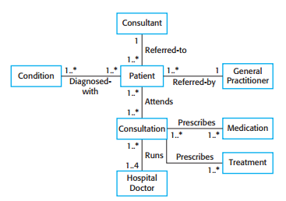
Structure Modeling
Class diagrams
Classes and associations in the MHC-PMS

Slide 38
Structure Modeling
Class diagrams
The above Figure develops this type of class diagram to show that objects of class Patient are also involved in relationships with a number of other classes.
In this example, it shows that you can name associations to give the reader an indication of the type of relationship that exists.
The UML also allows the role of the objects participating in the association to be specified.

Slide 39
Structure Modeling
Class diagrams
At this level of detail, class diagrams look like semantic data models.
Semantic data models are used in database design. They show the data entities, their associated attributes, and the relations between these entities.

Slide 40
Structure Modeling
Class diagrams
The UML does not include a specific notation for this database modeling as it assumes an object-oriented development process and models data using objects and their relationships.
We can use the UML to represent a semantic data model.
We can think of entities in a semantic data model as simplified object classes (they have no operations), attributes as object class attributes and relations as named associations between object classes.

Slide 41
Structure Modeling
Class diagrams
When showing the associations between classes, it is convenient to represent these classes in the simplest possible way.
To define them in more detail, you add information about their attributes (the characteristics of an object) and operations (the things that you can request from an object).
In the UML, you show attributes and operations by extending the simple rectangle that represents a class.

Slide 42
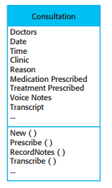
Structure Modeling
Class diagrams
The consultation class

Slide 43
Structure Modeling
Class diagrams
The name of the object class is in the top section.
The class attributes are in the middle section. This must include the attribute names and, optionally, their types.
The operations (called methods in Java and other OO programming languages) associated with the object class are in the lower section of the rectangle.

Slide 44
Structure Modeling
Generalization
Generalization is an everyday technique that we use to manage complexity. Rather than learn the detailed characteristics of every entity that we experience, we place these entities in more general classes (animals, cars, houses, etc.) and learn the characteristics of these classes.
This allows us to infer that different members of these classes have some common characteristics (e.g., squirrels and rats are rodents). We can make general statements that apply to all class members

Slide 45
Structure Modeling
Generalization
In modeling systems, it is often useful to examine the classes in a system to see if there is scope for generalization.
This means that common information will be maintained in one place only. This is good design practice as it means that, if changes are proposed, then you do not have to look at all classes in the system to see if they are affected by the change.
In object-oriented languages, such as Java, generalization is implemented using the class inheritance mechanisms built into the language.

Slide 46
Structure Modeling
Generalization
In a generalization, the attributes and operations associated with higher-level classes are also associated with the lower-level classes.
In essence, the lower-level classes are subclasses inherit the attributes and operations from their superclasses. These lower-level classes then add more specific attributes and operations.

Slide 47
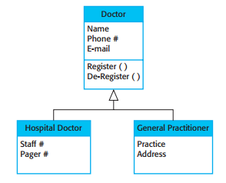
Structure Modeling
Generalization
A generalization hierarchy with added detail

Slide 48
Structure Modeling
Aggregation
Objects in the real world are often composed of different parts. For example, a study pack for a course may be composed of a book, PowerPoint slides, quizzes, and recommendations for further reading.
Sometimes in a system model, you need to illustrate this. The UML provides a special type of association between classes called aggregation that means that one object (the whole) is composed of other objects (the parts).
To show this, we use a diamond shape next to the class that represents the whole.

Slide 49
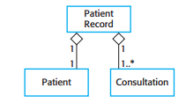
Structure Modeling
Aggregation
The aggregation association

